Slide 1

House prices in India
Submitted by:
Aiswarya Jeyabrinda S

Slide 2
Introduction
In this project, I've build a Machine Learning Model to predict the house prices in India.
This will be helpful in the real estate market.
This model can be used both house sellers and house buyers.

Slide 3
PROBLEM STATEMENT
Thousands of houses are sold every day. There are some questions every buyer asks himself like: What is the actual price that this house deserves? Am I paying a fair price?.

Slide 4
METHODOLOGY
DATA ACQUISITION
CLEANING THE DATA(EDA+FE)
DATA PREPARTION(SCALING , DUMMY )
MODEL BULIDING
VISUALIZATION

Slide 5
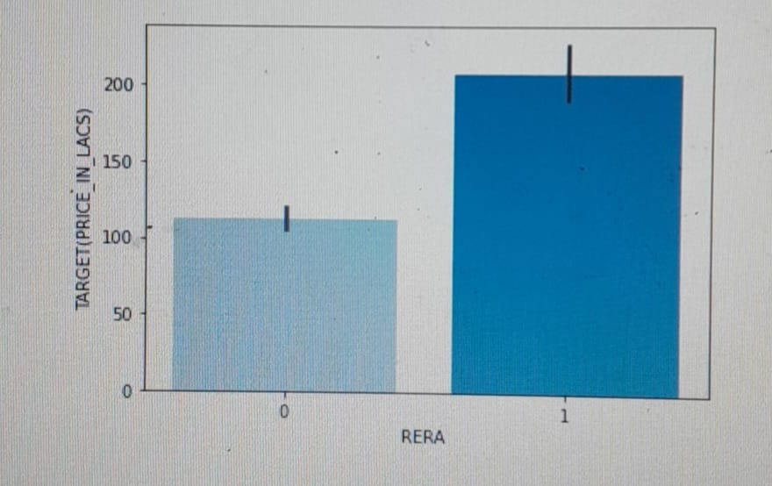
Illustration of some plots
The price of house with RERA approval is valued higher than the house without RERA approval

Slide 6
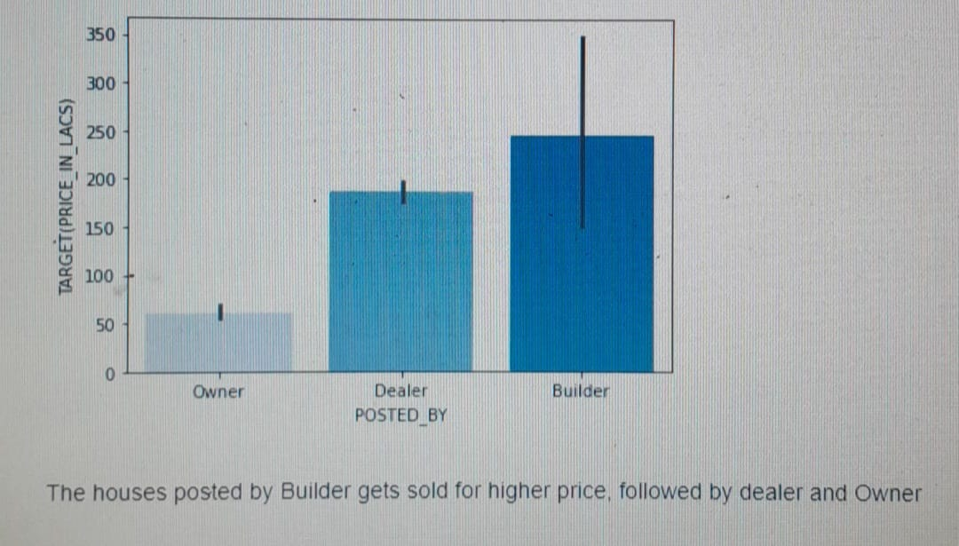

Slide 7
CONCLUSIONS
I've experimented with different Machine Learning algorithms to get the best model. When compared to all other algorithms, the Logistic Regression is BEST!

Slide 8
Thank You

